Slide 1
Transaction

Slide 2
Transaction
A transaction is an atomic unit of database access, which is either completely executed or not executed at all.
A transaction is a program that access the database in response to real world events.
All or nothing Principle
Example : Fund transfer.

Slide 3
Transaction: An executing program (process) that includes one or more database access operations
Read operations (database retrieval, such as SQL SELECT)
Write operations (modify database, such as SQL INSERT, UPDATE, DELETE)
Transaction: A logical unit of database processing
Example: Bank balance transfer of $100 dollars from a checking account to a saving account in a BANK database
Note: Each execution of a program is a distinct transaction with different parameters
Bank transfer program parameters: savings account number, checking account number, transfer amount
A transaction (set of operations) may be:
stand-alone, specified in a high level language like SQL submitted interactively, or
consist of database operations embedded within a program (most transactions)
Transaction boundaries: Begin and End transaction.
Note: An application program may contain several transactions separated by Begin and End transaction boundaries

Slide 4
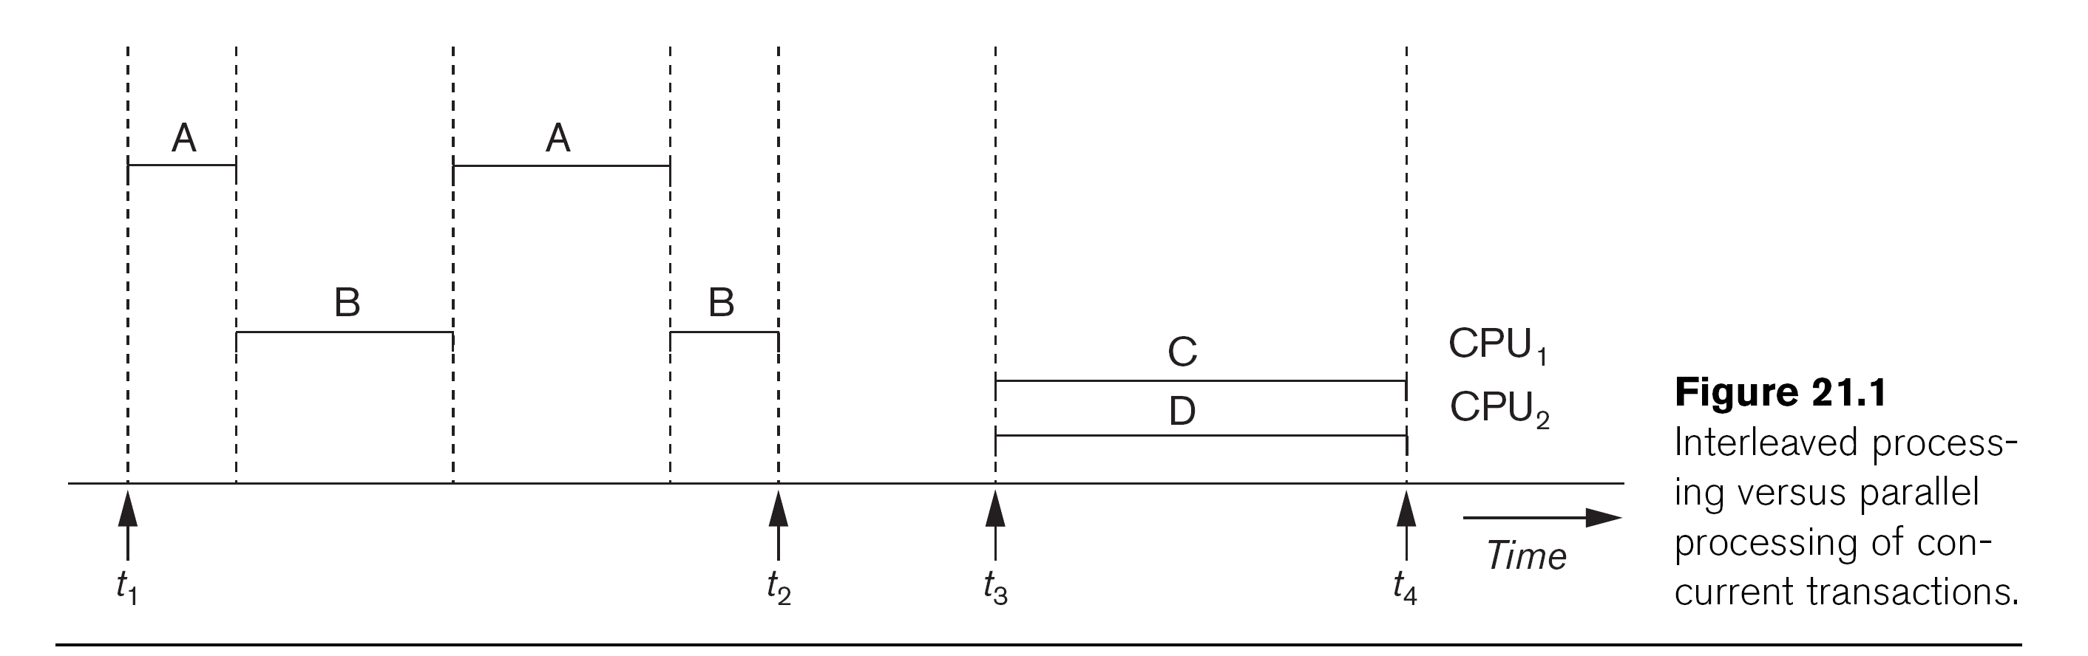
Transaction Processing Systems: Large multi-user database systems supporting thousands of concurrent transactions (user processes) per minute
Two Modes of Concurrency
Interleaved processing: concurrent execution of processes is interleaved in a single CPU
Parallel processing: processes are concurrently executed in multiple CPUs
Basic transaction processing theory assumes interleaved concurrency

Slide 5
Example of Transaction
Debit Transaction
Debit (Account_number, balance)
Begin Transaction
Read (Account_number, balance)
Balance =Balance-Withdrawal_amount
Write (Account_number, Balance)
End Transaction

Slide 6
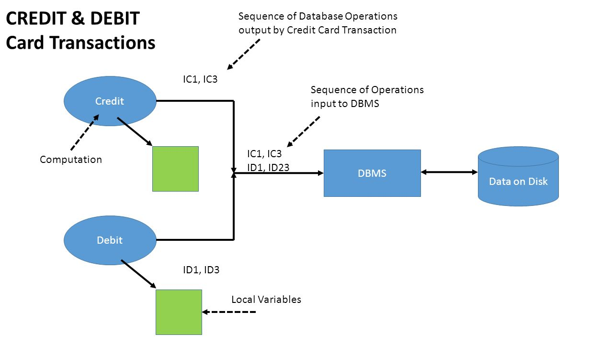

Slide 7
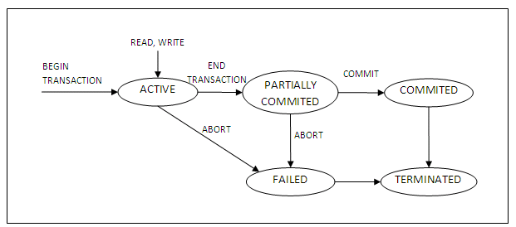
DBMS Transaction State Diagram

Slide 8
BEGIN_TRANSACTION: This marks the beginning of transaction execution.
Active State: A transaction enters into an active state when the execution process begins. During this state read or write operations can be performed. .
END_TRANSACTION: This specifies that READ and WRITE transaction operations have ended and marks the end of transaction execution. However, at this point it may be necessary to check whether the changes introduced by the transaction can be permanently applied to the database (committed) or whether the transaction has to be aborted because it violates serializability or for some other reason.

Slide 9
ROLLBACK (or ABORT): This signals that the transaction has ended unsuccessfully, so that any changes or effects that the transaction may have applied to the database must be undone.
Partially Committed: A transaction goes into the partially committed state after the end of a transaction.
Committed State: When the transaction is committed to state, it has already completed its execution successfully. Moreover, all of its changes are recorded to the database permanently.
Failed State: A transaction considers failed when any one of the checks fails or if the transaction is aborted while it is in the active state.

Slide 10
Terminated State: State of transaction reaches terminated state when certain transactions which are leaving the system can't be restarted.

Slide 11
ACID Properties
Atomicity: A transaction is a single unit of operation. You either execute it entirely or do not execute it at all. There cannot be partial execution.
Consistency: Once the transaction is executed, it should move from one consistent state to another.
Isolation: In a database system where more than one transaction are being executed simultaneously and in parallel, the property of isolation states that all the transactions will be carried out and executed as if it is the only transaction in the system. No transaction will affect the existence of any other transaction..
Durability: · After successful completion of a transaction, the changes in the database should persist. Even in the case of system failures.

Slide 12
Example of ACID
Transaction 1: Begin X=X+50, Y = Y-50 END
Transaction 2: Begin X=1.1*X, Y=1.1*Y END
Transaction 1 is transferring Rs. 50 from account X to account Y.
Transaction 2 is crediting each account with a 10% interest payment.
If both transactions are submitted together, there is no guarantee that the Transaction 1 will execute before Transaction 2 or vice versa.

Slide 13
Example of transaction
Transfer 50 from account A to account B
Read(A)
A = A - 50
Write(A)
Read(B)
B = B+50
Write(B)
Atomicity - shouldn’t take money from A without giving it to B
Consistency - money isn’t lost or gained
Isolation - other queries shouldn’t see A or B change until completion
Durability - the money does not go back to A
transaction

Slide 14
Basic operations in Transaction Processing
Basic operations on an item X:
read_item(X): Reads a database item named X into a program variable. To simplify our notation, we assume that the program variable is also named X.
write_item(X): Writes the value of program variable X into the database item named X
read_item(X) command includes the following steps:
Find the address of the disk block that contains item X.
Copy that disk block into a buffer in main memory (if that disk block is not already in some main memory buffer).
Copy item X from the buffer to the program variable named X.

Slide 15
write_item(X) command includes the following steps:
Find the address of the disk block that contains item X.
Copy that disk block into a buffer in main memory (if it is not already in some main memory buffer).
Copy item X from the program variable named X into its correct location in the buffer.
Store the updated block from the buffer back to disk (either immediately or at some later point in time).

Slide 16
Transaction Notation
Notation focuses on the read and write operations
Can also write in shorthand notation:
T1: b1; r1(X); w1(X); r1(Y); w1(Y); e1;
T2: b2; r2(Y); w2(Y); e2;
bi and ei specify transaction boundaries (begin and end)
i specifies a unique transaction identifier (TId)

Slide 17
Types of Failure
Computer Failure:
A hardware or software error on computer during transaction execution
Transaction Error:
Failure caused by an operation in the transaction.
Ex. Divide by zero.
Local Error
Condition that causes the cancelation of transaction.
Ex: Data needed for transaction not found

Slide 18
Types of Failure
Concurrency control enforcement
Transaction may be aborted by the concurrency control method.
Disk Failure: Loss of data blocks during a transaction due to, Say a disk read/write head crash.
Physical problems:
Problem like Power failure, Fire, etc..

Slide 19
Schedule
A schedule is a series of operations from one or more transactions. A schedule can be of two types:
Serial Schedule: When one transaction completely executes before starting another transaction, the schedule is called serial schedule. A serial schedule is always consistent. e.g.; If a schedule S has debit transaction T1 and credit transaction T2, possible serial schedules are T1 followed by T2 (T1->T2) or T2 followed by T1 ((T1->T2). A serial schedule has low throughput and less resource utilization.
Concurrent Schedule: When operations of a transaction are interleaved with operations of other transactions of a schedule, the schedule is called Concurrent schedule. e.g.; Schedule of debit and credit transaction should be concurrent in nature. But concurrency can lead to inconsistency in the database.

